Slide 1
Intro to Git and GitHub
Selena Deckelmann
Data Architect, Mozilla
@selenamarie - selena@chesnok.com
Notes:
Great to be at LISA. The first technical conference I ever attended was LISA in 1997. And the image that's stuck in my head ever since was costume party where a guy showed up wrapped in Saran Wrap, and wrote 'TCP' in sharpie across his chest. Get it? Yeah, TCPWrappers.
So it's a real privilege to be here. Many thanks to Carolyn for inviting me to talk about something that's become incredibly important to me in the last few years.

Slide 2
How we'll work together today
Notes:
And it comes down to this, we can't scale our training. We all have trouble hiring people who know what we want them to know, or training people to do the jobs that are out there.
I can't help but think that if this problem were exclusively one with machines, we'd start writing some awesome software for it...

Slide 3
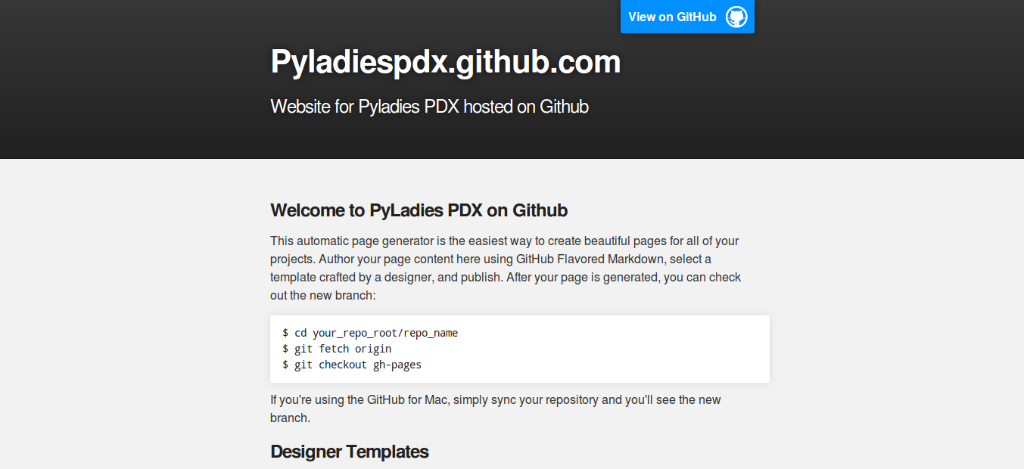
Notes:
And it comes down to this, we can't scale our training. We all have trouble hiring people who know what we want them to know, or training people to do the jobs that are out there.
I can't help but think that if this problem were exclusively one with machines, we'd start writing some awesome software for it...

Slide 4
Revision Control System:
What is it?
Notes:
And it comes down to this, we can't scale our training. We all have trouble hiring people who know what we want them to know, or training people to do the jobs that are out there.
I can't help but think that if this problem were exclusively one with machines, we'd start writing some awesome software for it...

Slide 5
(aka Version Control System)
Notes:
And it comes down to this, we can't scale our training. We all have trouble hiring people who know what we want them to know, or training people to do the jobs that are out there.
I can't help but think that if this problem were exclusively one with machines, we'd start writing some awesome software for it...

Slide 6
Revision Control System:
What is it?
Notes:
And it comes down to this, we can't scale our training. We all have trouble hiring people who know what we want them to know, or training people to do the jobs that are out there.
I can't help but think that if this problem were exclusively one with machines, we'd start writing some awesome software for it...

Slide 7
“A process for managing changes.”
Notes:
And it comes down to this, we can't scale our training. We all have trouble hiring people who know what we want them to know, or training people to do the jobs that are out there.
I can't help but think that if this problem were exclusively one with machines, we'd start writing some awesome software for it...

Slide 8
Why use Revision Control?
Notes:
And it comes down to this, we can't scale our training. We all have trouble hiring people who know what we want them to know, or training people to do the jobs that are out there.
I can't help but think that if this problem were exclusively one with machines, we'd start writing some awesome software for it...

Slide 9
Why use Revision Control?
Backups
Synchronize with others
Keep file history
Branch/Merge
Notes:
And it comes down to this, we can't scale our training. We all have trouble hiring people who know what we want them to know, or training people to do the jobs that are out there.
I can't help but think that if this problem were exclusively one with machines, we'd start writing some awesome software for it...

Slide 10
A Revision Control System includes:
Notes:
And it comes down to this, we can't scale our training. We all have trouble hiring people who know what we want them to know, or training people to do the jobs that are out there.
I can't help but think that if this problem were exclusively one with machines, we'd start writing some awesome software for it...

Slide 11
RCS includes:
Files
Directories
People
“the changes”
Notes:
And it comes down to this, we can't scale our training. We all have trouble hiring people who know what we want them to know, or training people to do the jobs that are out there.
I can't help but think that if this problem were exclusively one with machines, we'd start writing some awesome software for it...

Slide 12
Some definitions!
(handout)
Notes:
And it comes down to this, we can't scale our training. We all have trouble hiring people who know what we want them to know, or training people to do the jobs that are out there.
I can't help but think that if this problem were exclusively one with machines, we'd start writing some awesome software for it...

Slide 13
Repository or repo
A directory containing files and directories, a historical record of changes and the changes themselves.
Notes:
And it comes down to this, we can't scale our training. We all have trouble hiring people who know what we want them to know, or training people to do the jobs that are out there.
I can't help but think that if this problem were exclusively one with machines, we'd start writing some awesome software for it...

Slide 14
server
A central location for storing a repo.
Notes:
And it comes down to this, we can't scale our training. We all have trouble hiring people who know what we want them to know, or training people to do the jobs that are out there.
I can't help but think that if this problem were exclusively one with machines, we'd start writing some awesome software for it...

Slide 15
client
A user of a server.
Notes:
And it comes down to this, we can't scale our training. We all have trouble hiring people who know what we want them to know, or training people to do the jobs that are out there.
I can't help but think that if this problem were exclusively one with machines, we'd start writing some awesome software for it...

Slide 16
Working copy
A copy of the repo that is used by a client to make changes.
Notes:
And it comes down to this, we can't scale our training. We all have trouble hiring people who know what we want them to know, or training people to do the jobs that are out there.
I can't help but think that if this problem were exclusively one with machines, we'd start writing some awesome software for it...

Slide 17
Patch or Patch Set
Changes that can be applied to a repo.
Notes:
And it comes down to this, we can't scale our training. We all have trouble hiring people who know what we want them to know, or training people to do the jobs that are out there.
I can't help but think that if this problem were exclusively one with machines, we'd start writing some awesome software for it...

Slide 18
Distributed Version Control System
RCS that allows clients to make changes and exchange patch sets without consulting a server.
Notes:
And it comes down to this, we can't scale our training. We all have trouble hiring people who know what we want them to know, or training people to do the jobs that are out there.
I can't help but think that if this problem were exclusively one with machines, we'd start writing some awesome software for it...

Slide 19
Using Git
Flashcards!
Notes:
And it comes down to this, we can't scale our training. We all have trouble hiring people who know what we want them to know, or training people to do the jobs that are out there.
I can't help but think that if this problem were exclusively one with machines, we'd start writing some awesome software for it...

Slide 20
What is Git?
A revision control system that emphasizes fast branching, easy merging and distributed use.
Notes:
And it comes down to this, we can't scale our training. We all have trouble hiring people who know what we want them to know, or training people to do the jobs that are out there.
I can't help but think that if this problem were exclusively one with machines, we'd start writing some awesome software for it...

Slide 21
What is Git?
Efficient branching
git checkout -b newbranch
Notes:
And it comes down to this, we can't scale our training. We all have trouble hiring people who know what we want them to know, or training people to do the jobs that are out there.
I can't help but think that if this problem were exclusively one with machines, we'd start writing some awesome software for it...

Slide 22
What is Git?
Efficient branching
git checkout master
git merge newbranch
Notes:
And it comes down to this, we can't scale our training. We all have trouble hiring people who know what we want them to know, or training people to do the jobs that are out there.
I can't help but think that if this problem were exclusively one with machines, we'd start writing some awesome software for it...

Slide 23
git init
Notes:
And it comes down to this, we can't scale our training. We all have trouble hiring people who know what we want them to know, or training people to do the jobs that are out there.
I can't help but think that if this problem were exclusively one with machines, we'd start writing some awesome software for it...

Slide 24
git clone
Notes:
And it comes down to this, we can't scale our training. We all have trouble hiring people who know what we want them to know, or training people to do the jobs that are out there.
I can't help but think that if this problem were exclusively one with machines, we'd start writing some awesome software for it...

Slide 25
git diff
Notes:
And it comes down to this, we can't scale our training. We all have trouble hiring people who know what we want them to know, or training people to do the jobs that are out there.
I can't help but think that if this problem were exclusively one with machines, we'd start writing some awesome software for it...

Slide 26
git branch
Notes:
And it comes down to this, we can't scale our training. We all have trouble hiring people who know what we want them to know, or training people to do the jobs that are out there.
I can't help but think that if this problem were exclusively one with machines, we'd start writing some awesome software for it...

Slide 27
git checkout
Notes:
And it comes down to this, we can't scale our training. We all have trouble hiring people who know what we want them to know, or training people to do the jobs that are out there.
I can't help but think that if this problem were exclusively one with machines, we'd start writing some awesome software for it...

Slide 28
git status
Notes:
And it comes down to this, we can't scale our training. We all have trouble hiring people who know what we want them to know, or training people to do the jobs that are out there.
I can't help but think that if this problem were exclusively one with machines, we'd start writing some awesome software for it...

Slide 29
git pull
Notes:
And it comes down to this, we can't scale our training. We all have trouble hiring people who know what we want them to know, or training people to do the jobs that are out there.
I can't help but think that if this problem were exclusively one with machines, we'd start writing some awesome software for it...

Slide 30
git push
Notes:
And it comes down to this, we can't scale our training. We all have trouble hiring people who know what we want them to know, or training people to do the jobs that are out there.
I can't help but think that if this problem were exclusively one with machines, we'd start writing some awesome software for it...

Slide 31
git add
Notes:
And it comes down to this, we can't scale our training. We all have trouble hiring people who know what we want them to know, or training people to do the jobs that are out there.
I can't help but think that if this problem were exclusively one with machines, we'd start writing some awesome software for it...

Slide 32
git commit
Notes:
And it comes down to this, we can't scale our training. We all have trouble hiring people who know what we want them to know, or training people to do the jobs that are out there.
I can't help but think that if this problem were exclusively one with machines, we'd start writing some awesome software for it...

Slide 33
git reset
Notes:
And it comes down to this, we can't scale our training. We all have trouble hiring people who know what we want them to know, or training people to do the jobs that are out there.
I can't help but think that if this problem were exclusively one with machines, we'd start writing some awesome software for it...

Slide 34
git merge
Notes:
And it comes down to this, we can't scale our training. We all have trouble hiring people who know what we want them to know, or training people to do the jobs that are out there.
I can't help but think that if this problem were exclusively one with machines, we'd start writing some awesome software for it...

